Slide 1
Carrier Tracker Beta 1.0
Simplicity is sophistication

Slide 2
All slides
Scope
Flow diagram
Features
Issues
Demo
QA

Slide 3
CarrierTracker Scope
Database
Update Info table
Insert History
Insert Log
Log files
Email

Slide 4
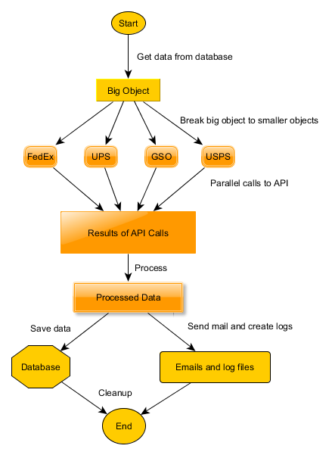
Flow

Slide 5
Features
Single thread asynchronous
Auto adjust speed
Boundary conditions
Kill process after fix time
Stops sending requests after max queue achieved
Stops processing for carrier after max api errors
Stops database operations after max db errors
Multiple Connections to database
Configuration
Database logging
File logging
Status mail
10,000 records in 4 minutes

Slide 6
Issues
Accuracy
Error and exception handling in database
FedEx status > 50 chars issue
USPS site not working
> 50K records memory heavy
Uses 1 GB

Slide 7
Pending
400 error handling for GSO
Handle minor issues relating to exceptions and errors handling
Stop database update after max database errors
Stop calling API after max no of errors reached
Code cleanup
Documentation
Release

Slide 8
Demo
Show local run with 10k records
Piston
Logging
2 second snapshot
Memory foot print
Discuss configurations
Show Azure run

Slide 9
QA
Code review

